Slide 1

Financial Analysis of Different Sectors Healthcare, Financial, Automobile, and Semiconductor
ISM 6419 – Data Visualization
Prachi Shivam Parashar

Slide 2
Data Sources
Yahoo Finance: Financial statements (Balance Sheets, Income Statements,
Cash Flow Statements).
Kaggle: Tesla car sales data.
IMF GDP Data
CO2 Emissions Data
Financial analysis is the process of examining a company's financial information to evaluate its performance and make business decisions

Slide 3
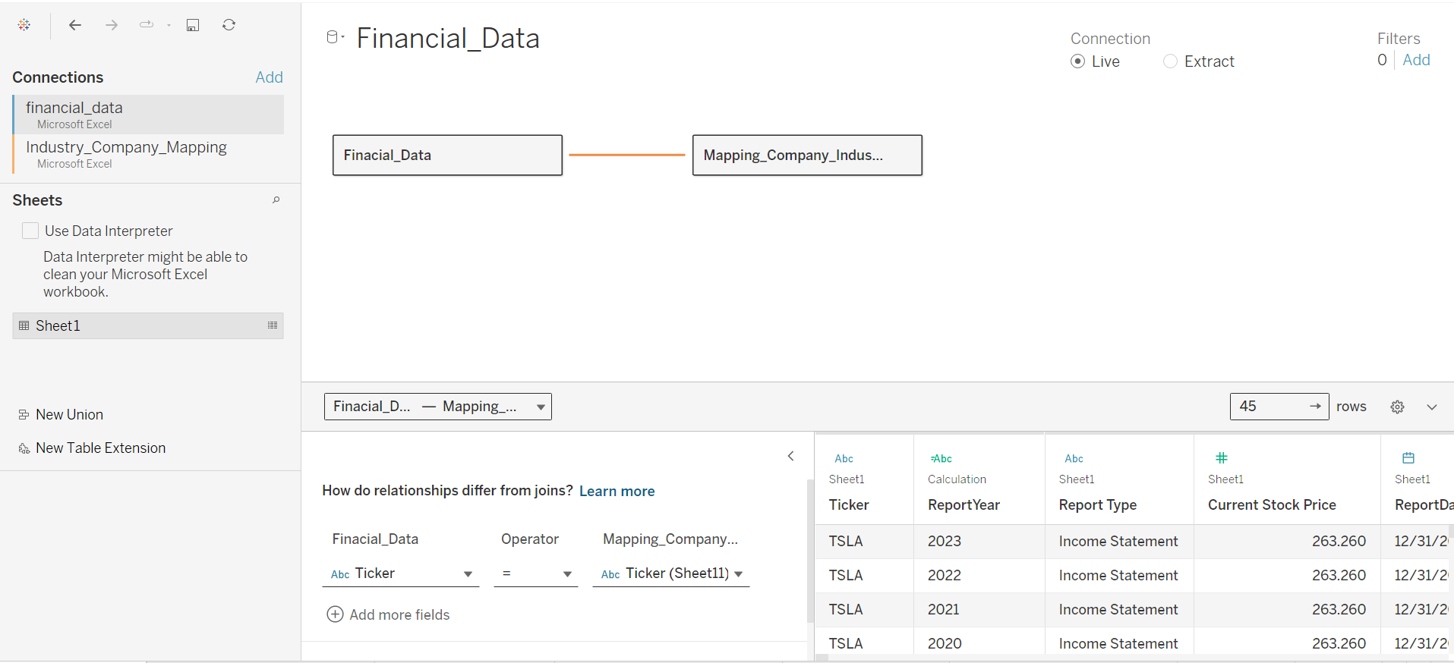

Slide 4
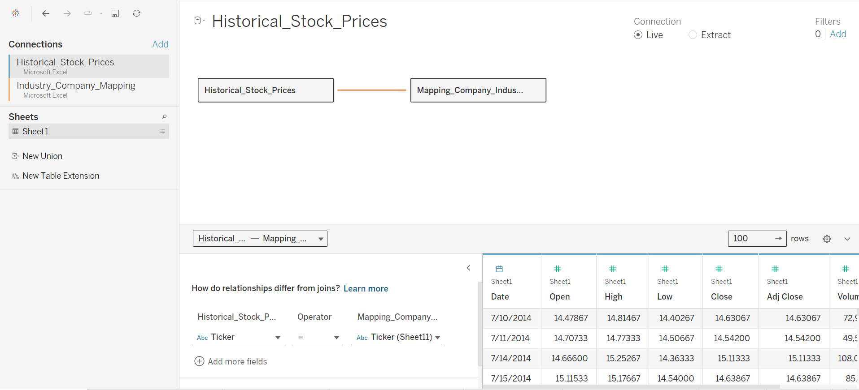

Slide 5
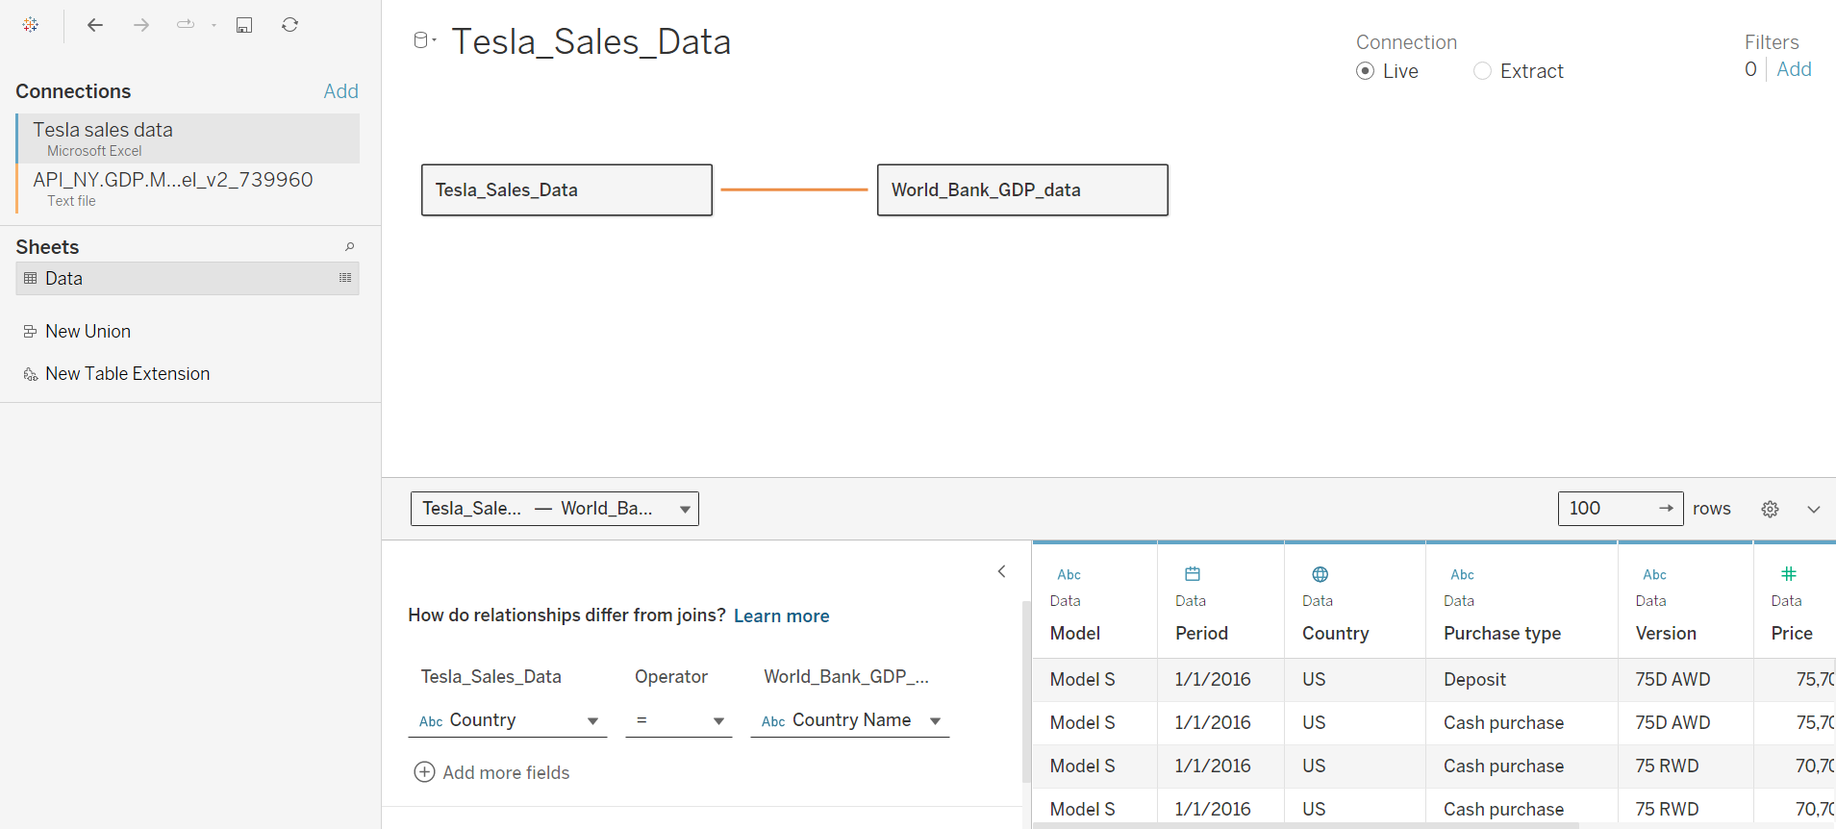

Slide 6
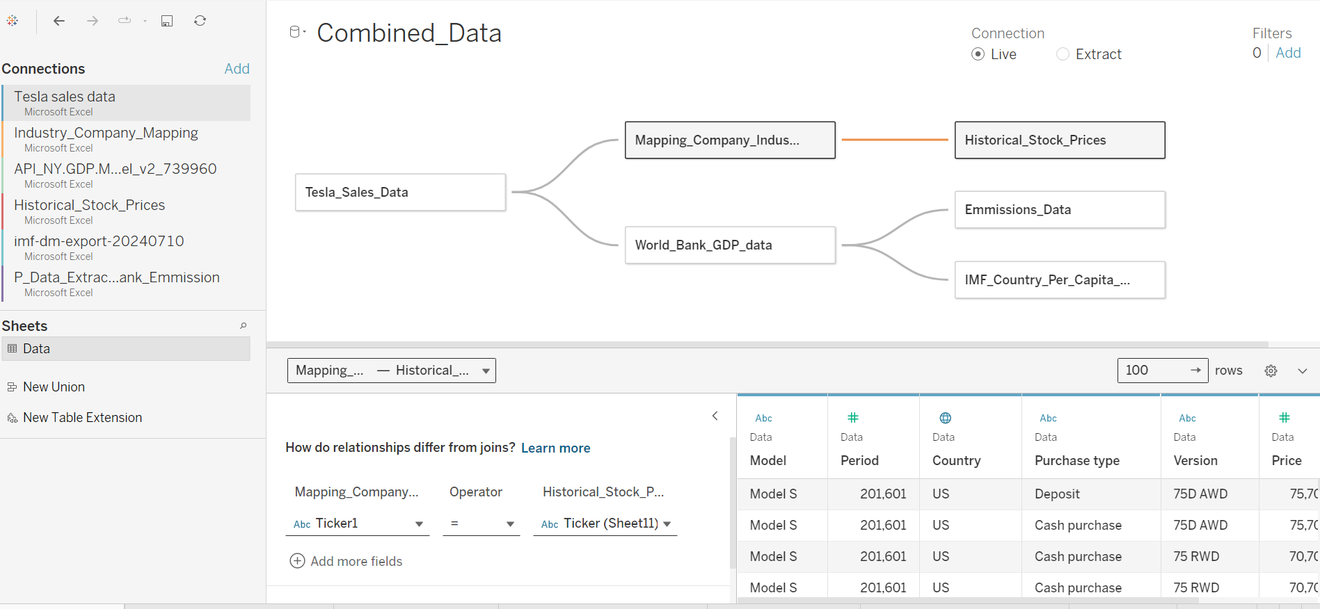

Slide 7
Research Questions
What are the key financial metrics and ratios that indicate the health and performance of companies within the healthcare, financial, automobile, and semiconductor sectors?
What is the Average Current ratio, EPS, D/E, Operating cash flow by Industry?
Average Gross Profit of Different models of tesla?
What are the trends in average gross profit and average price for each country?
What is Tesla model cars sales?
Which is the most profitable tesla model?
Financial analysis is the process of examining a company's financial information to evaluate its performance and make business decisions

Slide 8
Research Questions
What type of visualization would effectively display emissions data for various countries?
What type of visualization would best display the average closing prices of sector stocks?
Provide a sector-specific visualization of the industry's average closing prices?
Which sector shows the most promise for investment based on financial performance?
Within each sector, which company demonstrates the strongest financial health and growth potential?
Financial analysis is the process of examining a company's financial information to evaluate its performance and make business decisions

Slide 9
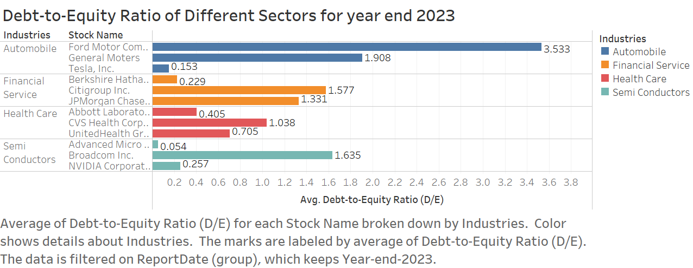

Slide 10
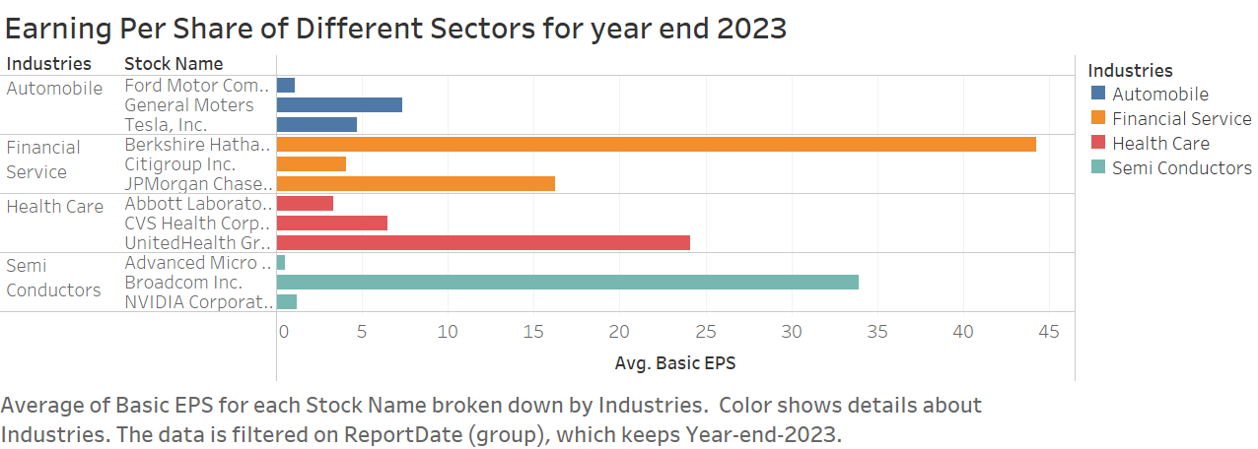

Slide 11
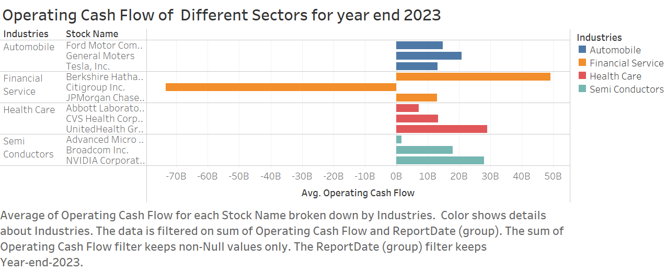

Slide 12
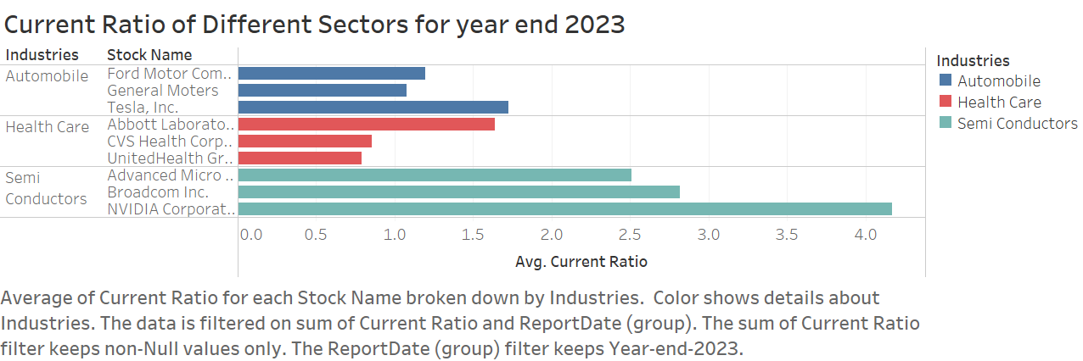

Slide 13
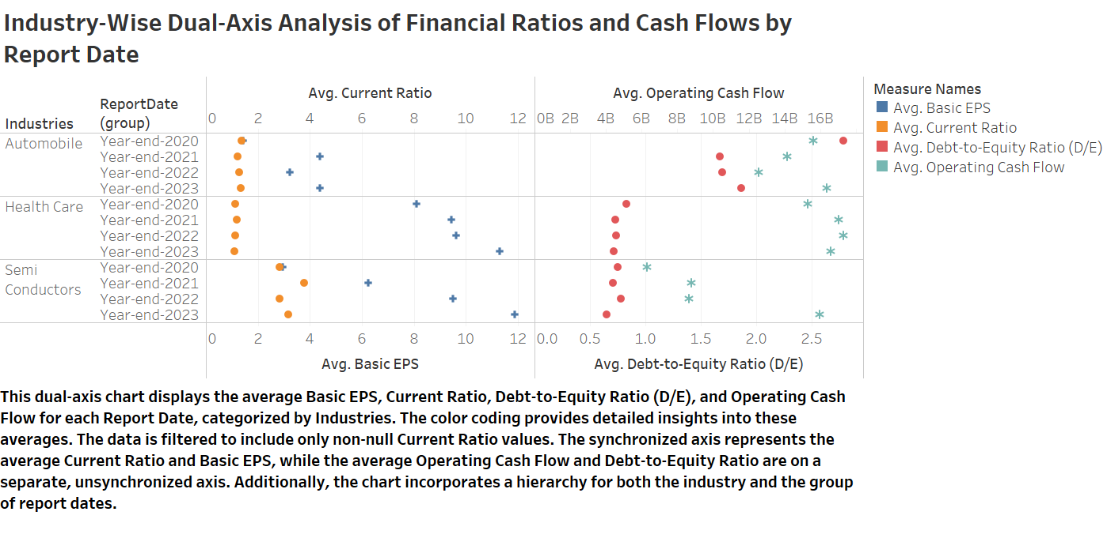

Slide 14
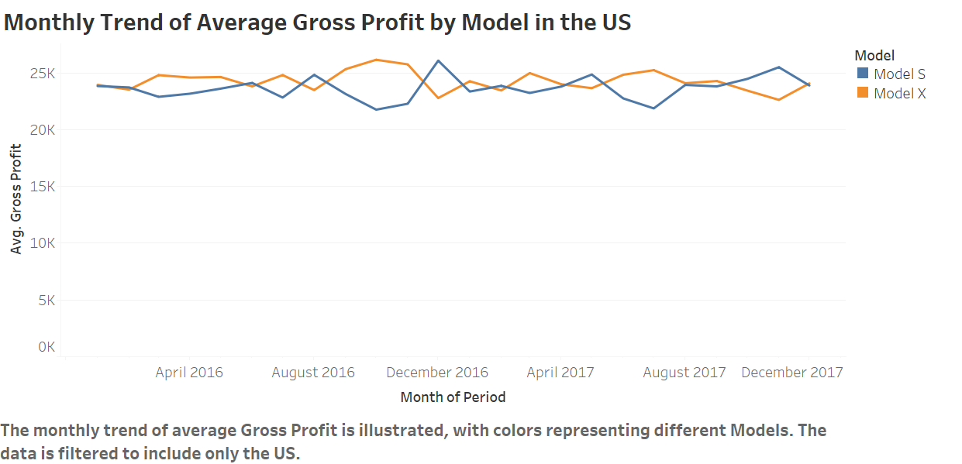

Slide 15
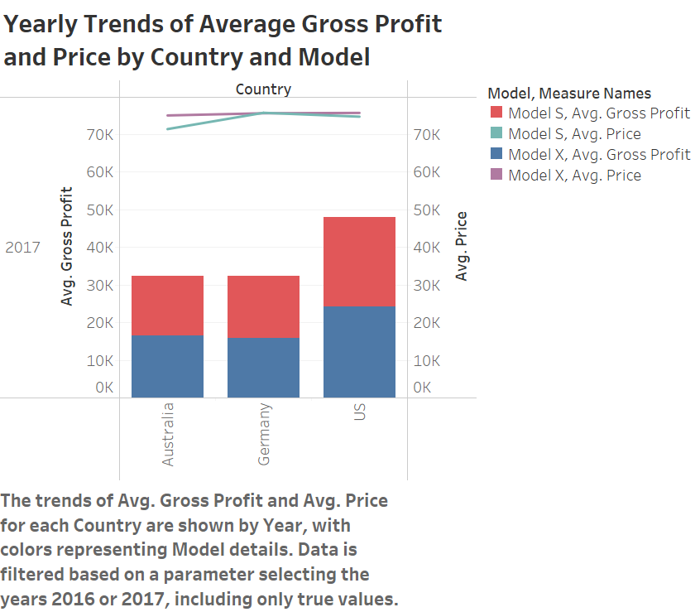

Slide 16
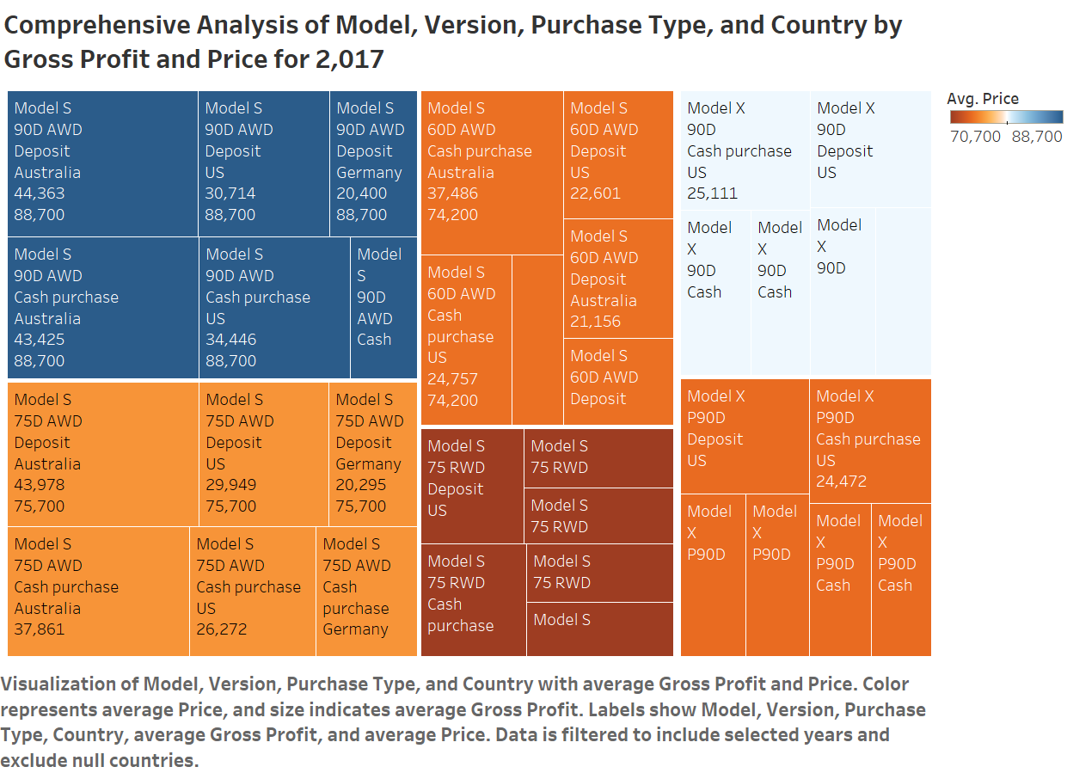

Slide 17
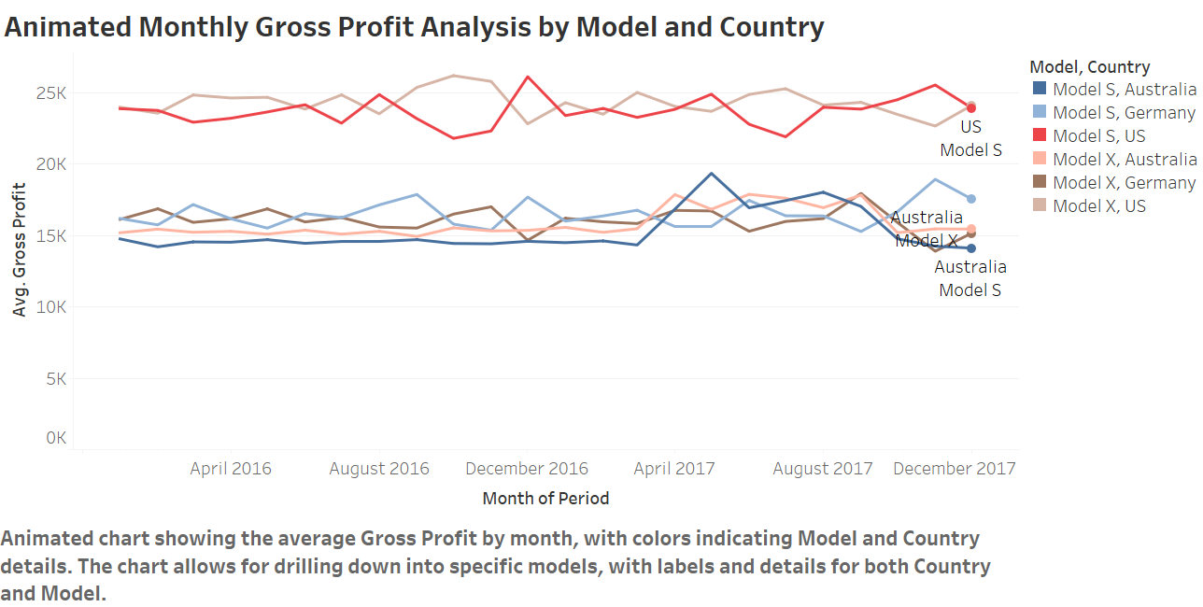

Slide 18
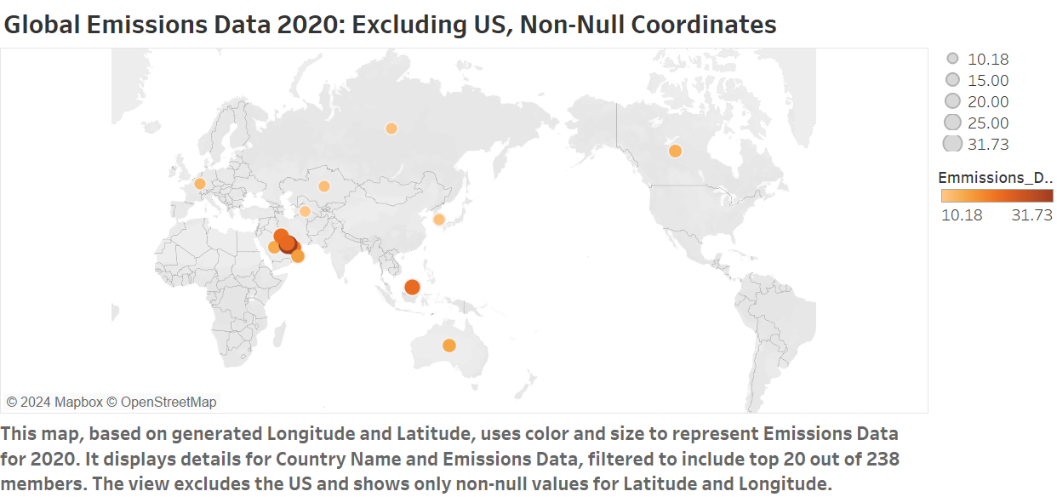

Slide 19
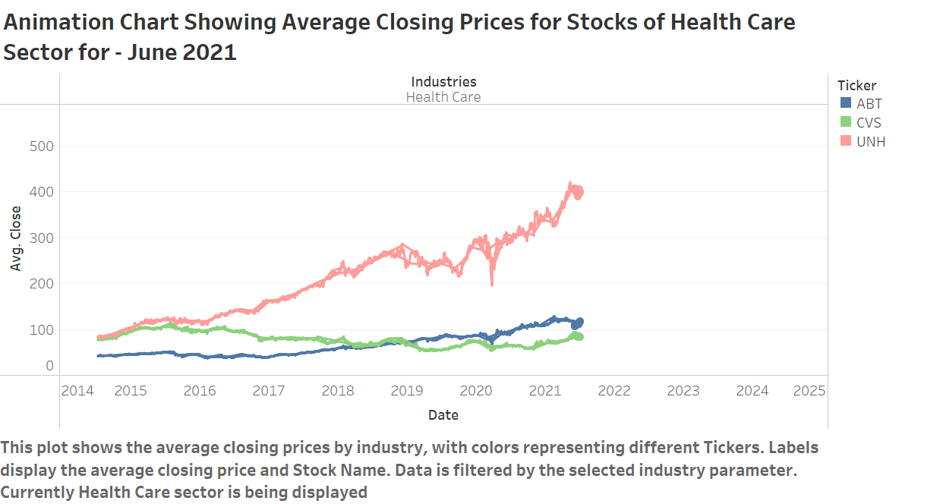

Slide 20
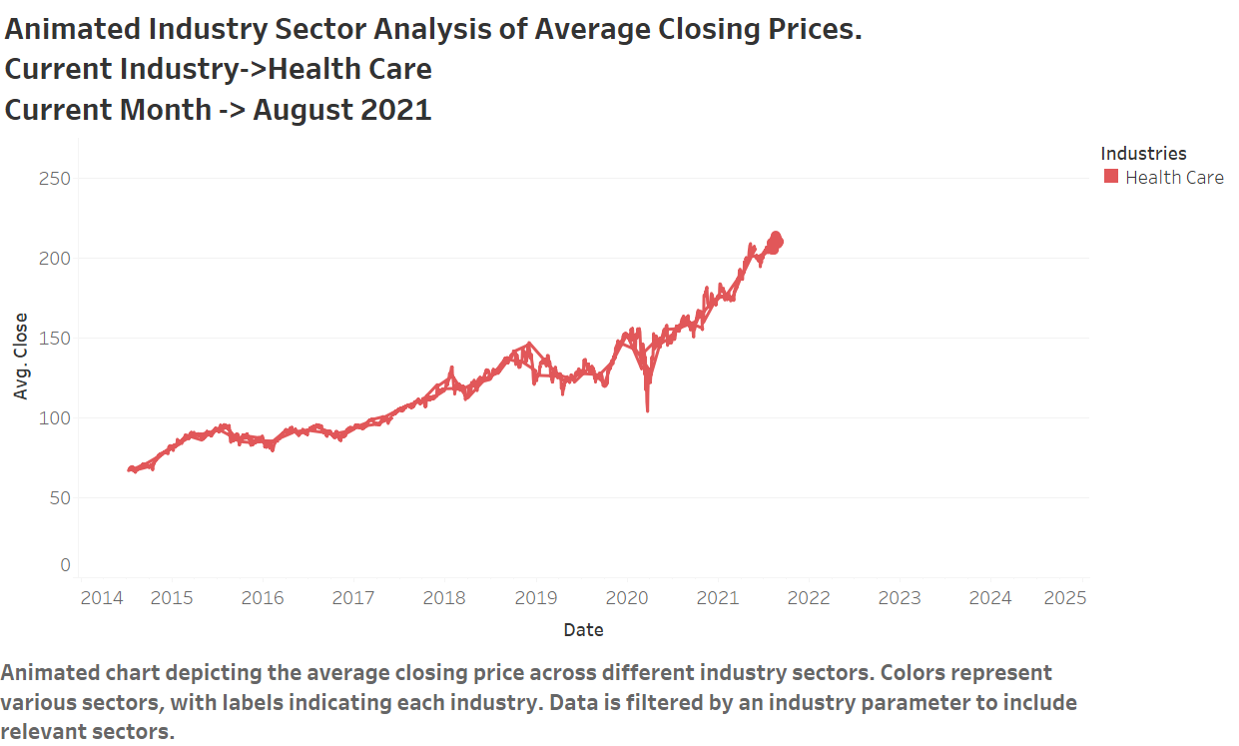

Slide 21
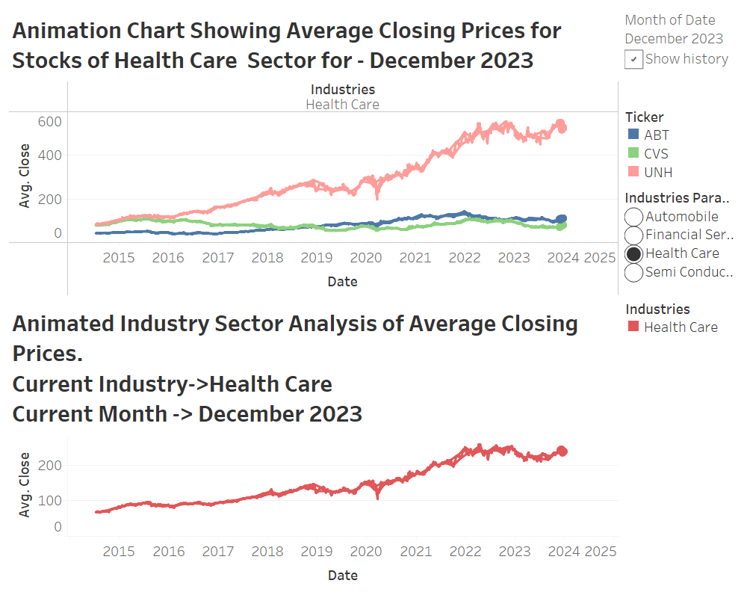

Slide 22
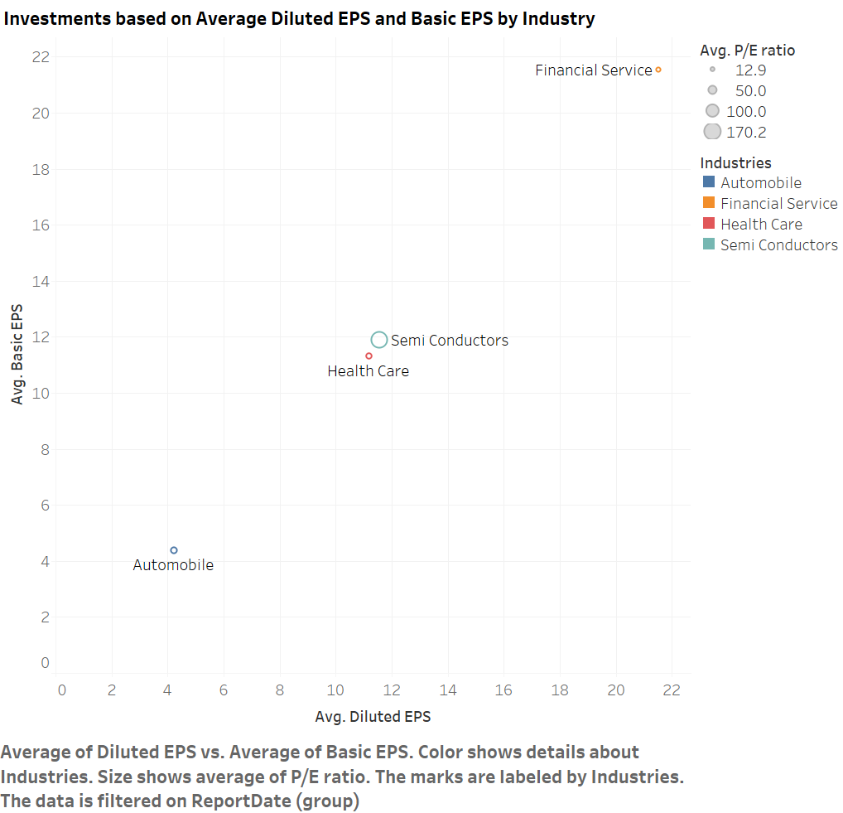

Slide 23
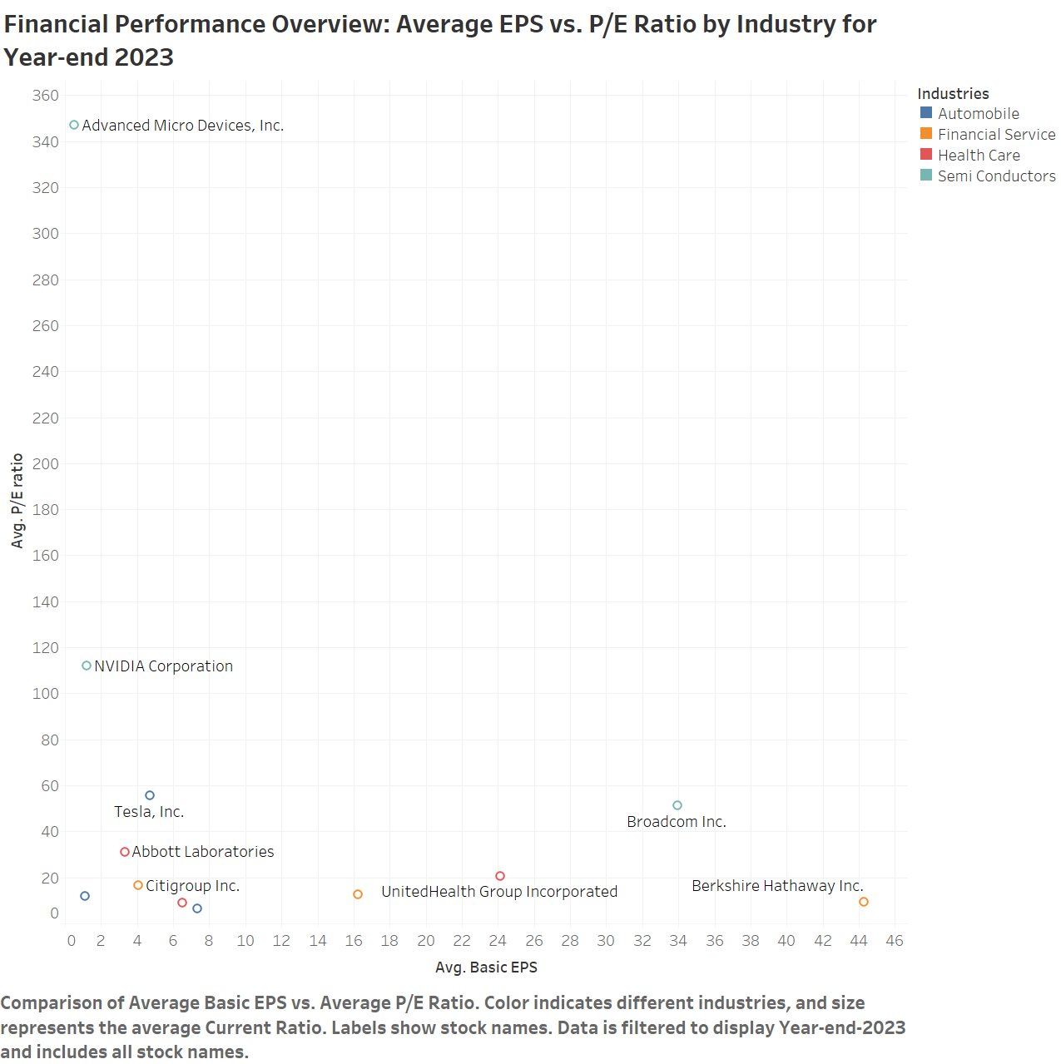

Slide 24
